Slide 1
EXAMINATION READINESS
STUDENTS

Slide 2
EXAM PERMITS
This is the document that allows you to enter the examination venue.
The dates and times of each subject’s examination is indicated on the permit.
Some students will not be able to write certain subjects due to the following reasons:
*Attendance
*Did not reach sub minimum year mark.
Your permit will be scratched (the subject you may not write will be scratched through and the reason will be indicated next to it)
IF you are repeating a subject on a different level you will receive a separate exam permit for that subject.

Slide 3
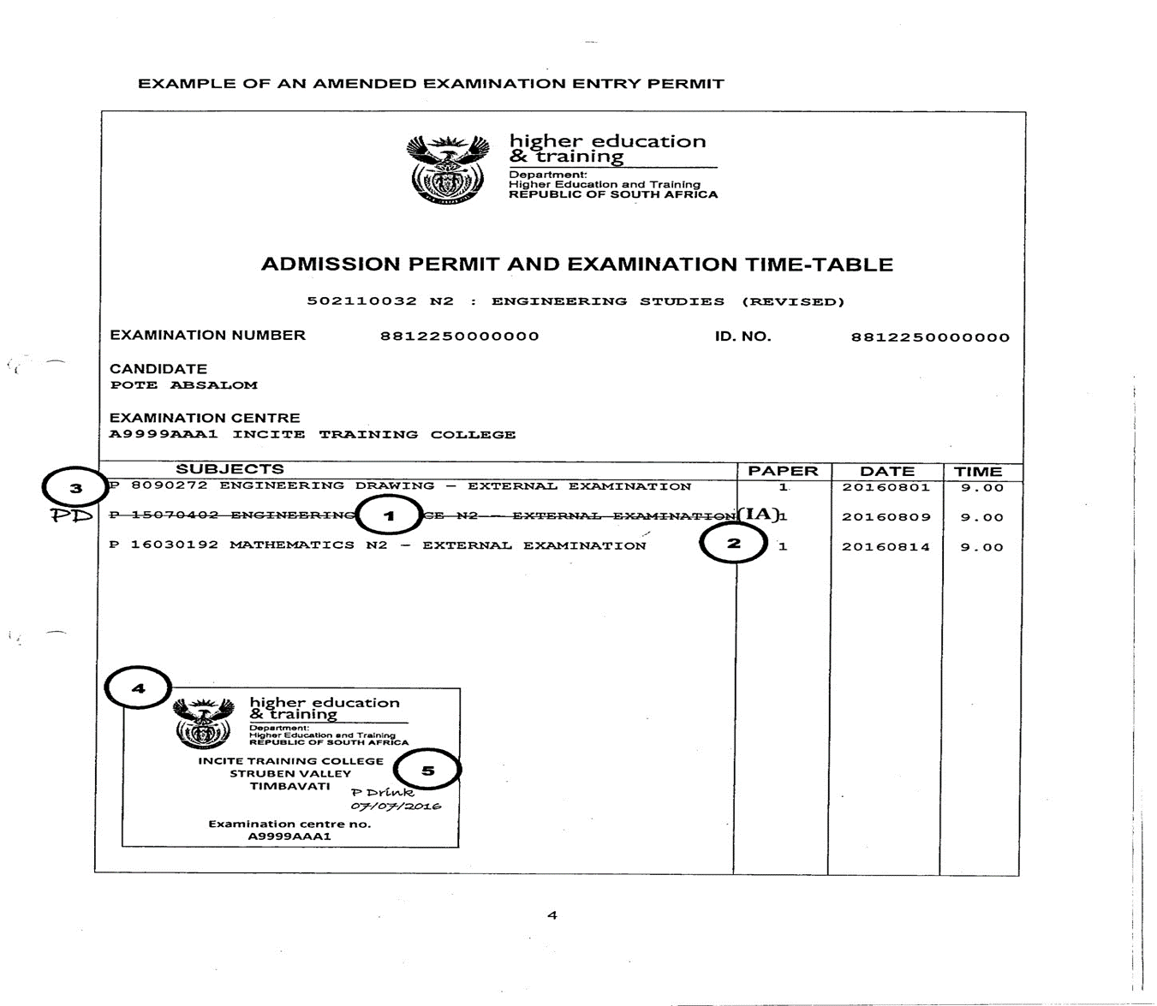

Slide 4
EXAM PERMITS
DO NOT WRITE ANYTHING ON YOUR EXAM PERMIT……KEEP IT CLEAN AND NEAT
DO NOT HIGHLIGHT OR SCRATCH OUT THE SUBJECTS AS YOU HAVE COMPLETED IT!!

Slide 5
WHAT TIME do we start?
Students should be on campus ONE hour before the exam commences: (08:00 for Morning Session &
12:00 for Afternoon Session)

Slide 6
STEPS:
Check your venue and seating on online notice board:
This is available the evening before subject is written
2. Go to the venue on the seating plan
Outside venue: your ID document and exam permit will be checked.

Slide 7
4. All students must record their time of leaving when they are done writing.
No congregation of students are allowed on the premises.
Please leave immediately after your exam.

Slide 8
ACTIVITY | X-PAPER | Y-PAPER
PROCEED TO VENUE | 08:00 | 12:00
SEATED | 08:30 | 12:30
Doors close: | 08:30 | 12:30
AFTER DOORS ARE CLOSED NO OTHER CANDIDATE IS ALLOWED IN THE VENUE UNTIL THE COMMENCEMENT OF THE EXAMINATION – 09:00 or 13:00. Students arriving after doors are closed: redirected to HOLDING ROOM

Slide 9
As from January 2020, in accordance with the National examinations and Assessment Policy, Candidates will NOT be allowed to arrive late for ANY National examinations.
IF you arrive late (09:01/13:01) you will not be permitted into the venue.

Slide 10
ACTIVITY | X-PAPER | Y-PAPER
Students are seated | 08:30 | 12:30
Examination instructions are read | 08:30 | 12:30
Answer books distributed & Cover pages completed | 08:35 – 08:45 | 12:35 – 12:45
Question papers issued | 08:45 | 12:45
Reading time (PLEASE NOTE: candidates are not allowed to make any notes during reading time) | 08:50 – 09:00 | 12:50 – 13:00
Examination commences | 09:00 | 13:00

Slide 11
THE SEATING PLAN
All candidates will be seated according to a seating plan
Seating arranged according to ID numbers
Seating plans displayed daily outside each venue
Seating plans will also be published a day prior to the examination date on the campus online noticeboard
Candidates should adhere strictly to seating plan

Slide 12
Please refer to: ikhala.coltech.co.za DAILY to access seating plan

Slide 13
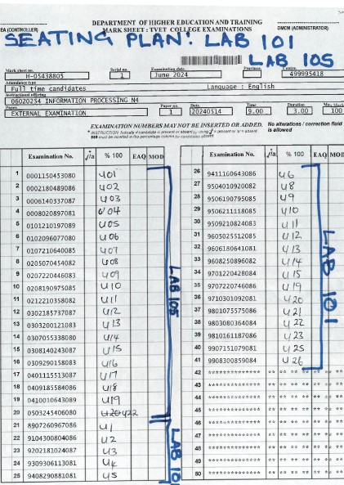
SEATING PLAN
Check your subject
Check your VENUE & SEAT

Slide 14
Items allowed in exam venue
Valid RSA ID (Compulsory to enter venue)
Passport (for candidates who are not RSA citizens)
Examination Permit (Compulsory to enter venue)
Writing utensils (Blue or Black pen, Ruler, etc.)
Non-programmable calculator without a cover (unless prohibited by examiner)

Slide 15
Items NOT ALLOWED IN EXAM VENUE
Cell phones: Under NO circumstances allowed in exam venue - IRREGULARITY
(College accepts no liability for losses)
Pencil cases & Pencil bags
Programmable calculators
Calculator covers
Hats/caps
No bags
No crib notes in any form – not on body, stationery, hair, exam permits, ID books
No books, notes, previous question papers / memos

Slide 16
BAGS / CELL PHONES THE LECTURER MAY NOT KEEP YOUR CELLPHONE OR BAG FOR YOU, THEY ARE ON EXAM DUTY! BAGS ARE STORED AT YOUR OWN RISK!

Slide 17
** As soon as you enter; you are under the instruction of the Chief Invigilator **Find correct seat according to seating plan **Place Exam permit & ID on top left side of desk for duration of exam **Complete cover of answer book correctly – see example below **Candidates whose exam numbers do not appear on the seating plan, are not allowed in the examination venue.
When you enter the exam venue

Slide 18
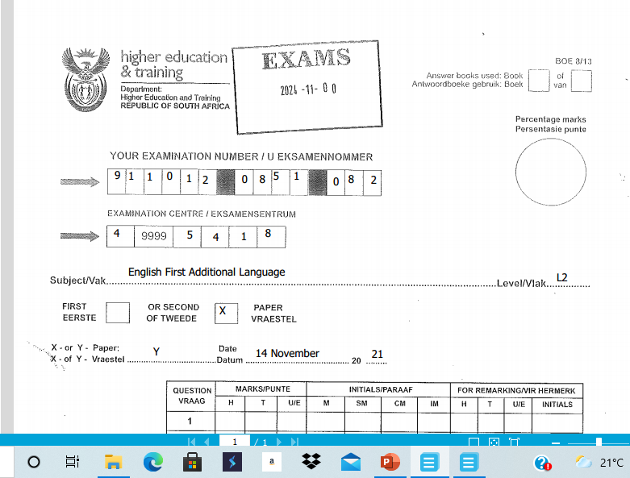
NOTE:
Unique code for the day
NC(V)
ANSWERBOOK

Slide 19
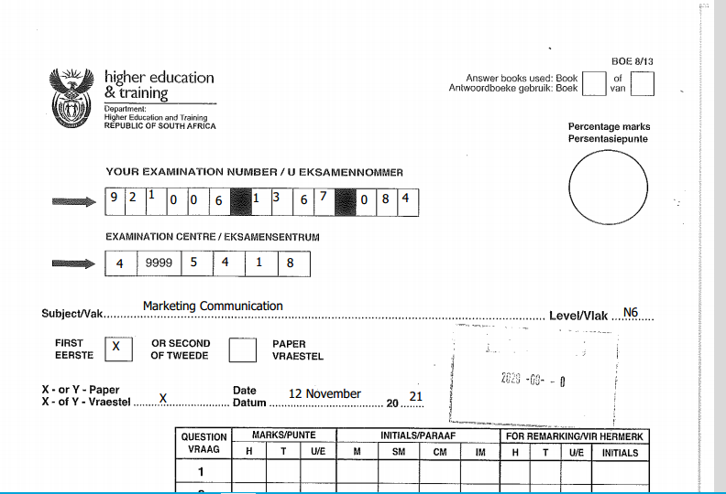
REPORT 191 ANSWER BOOK

Slide 20
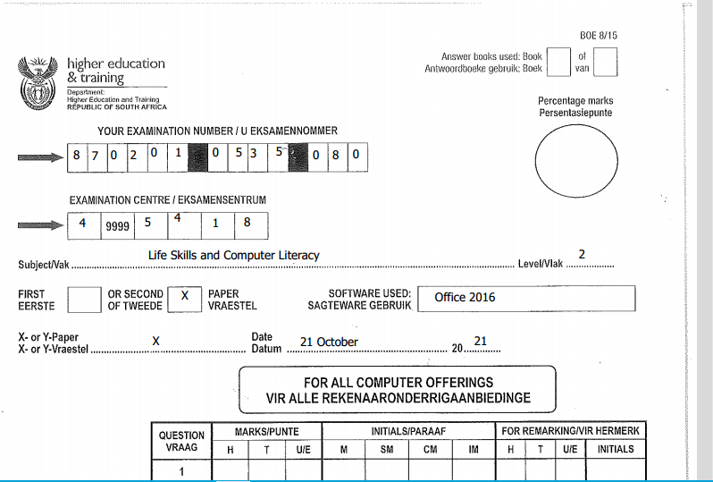
COMPUTER ANSWERBOOK

Slide 21
OPEN & CLOSED BOOK EXAMINATIONS (REPORT 191 ONLY)
SUBJECT | OPEN BOOK | CLOSED BOOK | REFERENCE MATERIAL ALLOWED IN EXAM VENUE
Man. Comm N4 P1 | yes |  | TWO dictionaries and two additional reference works
Man. Comm N4 P2 |  | yes | TWO dictionaries (NO additional reference works)
Communication N4 – N6 P1 | Yes |  | TWO dictionaries AND two additional reference works
Communication N4 – N6 P2 |  | Yes | TWO dictionaries (no additional reference works)
Entrep. & Bus. Man N4 – N6 P1 |  | yes | NONE
Entrep. & Bus. Man N4 – N6 P2 | Yes |  | FIVE reference works: dictionaries, pocket calculator, textbook, student files containing lesson notes
PAST PAPERS AND MARKING GUIDELINES ARE NOT PERMITTED IN THE EXAM VENUE

Slide 22
COMPUTER – RELATED EXAMINATIONS
Make sure you are seated 40 minutes before the start of the Computer examination time
This time is for reading and implementing instructions.
All computer printouts must have the student’s examination number and watermark.
Printouts without identification or with handwritten identity number will NOT be considered for marking.
Candidates print during the examination. The invigilator will bring printouts to work station.
No extra time will be allocated for loss of work.
Save your work correctly.
TYPE SAVE PRINT !!

Slide 23
SPEED AND ACCURACY TEST: (Office Admin Students) 1. In the last 5 minutes BEFORE THE START of the examination, the candidates’ focus will be on the Speed & Accuracy test and they will be given 3 minutes to read through the Speed & Accuracy test 2. Candidates must wait until the invigilator gives the instruction to begin and stop. 3. The speed & accuracy test will be conducted ONCE ONLY 4. All uncontrolled speed & accuracy tests will NOT be marked.
COMPUTER – RELATED EXAMINATIONS

Slide 24
ABSENTEEISM FROM EXTERNAL EXAMINATIONS
IF you miss the exam because of a valid reason you may apply for exemption and a Supplementary Examination during the following examination cycle .
All medical notes / certificates must be submitted within 48 hours!
If the reason is NOT VALID / or the medical note was not received; you will have to repeat the subject full time.
Where a subject consists of TWO papers – you will repeat the subject if ONE of the two papers are NOT written!

Slide 25
Failure to produce valid ID or passport or exam permit
Report to reception for identification or reprint of your permit
Report to venue with document issued to you
Submit your valid ID within 24 hours to the Examinations Officer.
Failure to do so will result in your script being handled as an IRREGULARITY

Slide 26
DURING THE EXAMINATION SESSION
1. Do not tear out ANY pages from the answer book 2. Ensure addenda are completed & inserted in your answer book 3. Only use exam numbers, NO NAMES 4. During the first hour, no candidate is allowed to leave the venue 5. Candidates to sign Attendance Register next to ID number 6. Candidates have to be escorted to the toilet and back (not during 1st hour)

Slide 27
On completion of the exam candidates must remain seated and raise his/her hand to indicate to the invigilator to collect the answer script & question paper A Candidate must sign for submission of answer book next to his/her ID number. During the last 15 minutes of the exam session, candidates must remain seated until all scripts, question papers and signatures are collected – no candidates allowed to leave the venue during last 15 minutes. Candidates will sign the register indicating the time they left/completed the session.
DURING THE EXAMINATION SESSION

Slide 28
Leaked question papers/marking guidelines. It is a criminal offence to make use of leaked information, (Report leakages to CHIEF INVIGILATOR) Candidates found writing of behalf of other candidates Failure to produce a valid ID Late arrival at exam centre
IRREGULARITIES

Slide 29
IRREGULARITIES
Exam number not on mark sheet
Answer script damaged
Creating a disturbance or behave in an improper manner
Disorderly conduct
Disregard of instructions from Invigilator/s
Disregard of Examination regulations

Slide 30
IRREGULARITIES
When found in possession of crib (cheat) notes or on cell phone, evidence will be confiscated.
New exam book issued to continue with exam.
An irregularity will be declared.
This is a serious offence!
A student may be barred from ANY institution for THREE years!

Slide 31
QUESTIONS?

