Slide 1


EXAMINATION READINESS
STUDENTS

Slide 2

EXAM PERMITS
This is the document that allows you to enter the examination venue.
The dates and times of each subject’s examination is indicated on the permit.
Some students will not be able to write certain subjects due to the following reasons:
*Attendance
*Did not reach sub minimum year mark.
Your permit will be scratched (the subject you may not write will be scratched through and the reason will be indicated next to it)
IF you are repeating a subject on a different level you will receive a separate exam permit for that subject.

Slide 3
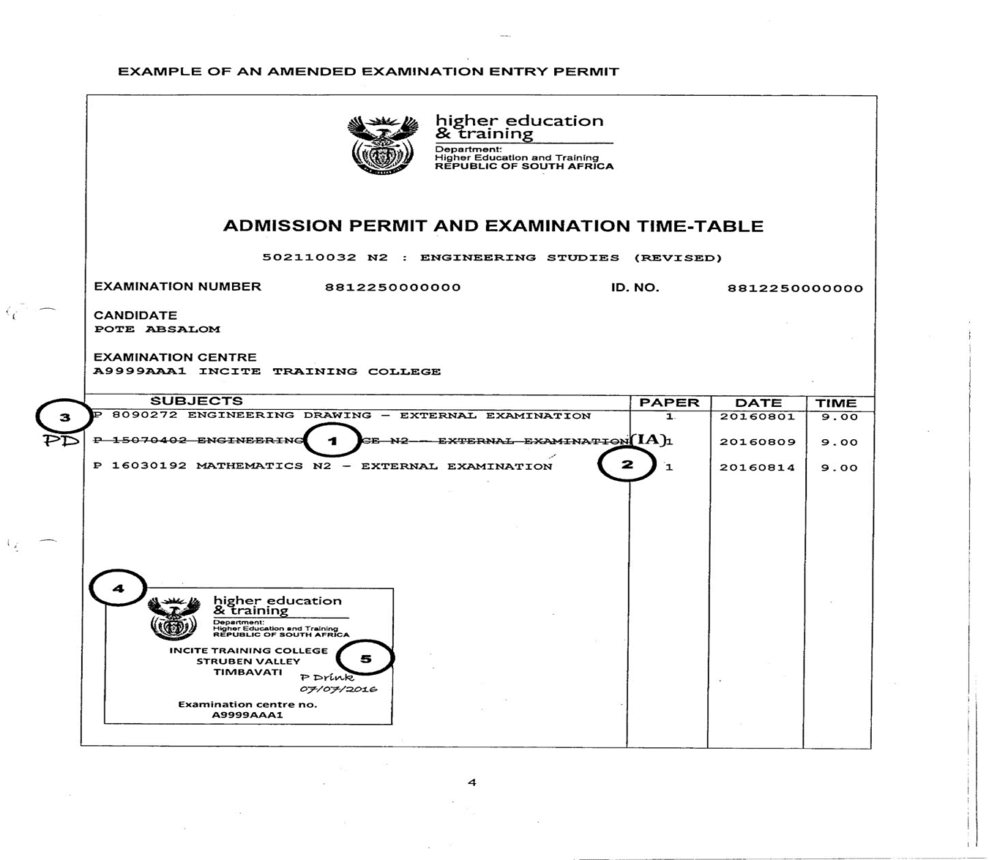

Slide 4
EXAM PERMITS
DO NOT WRITE ANYTHING ON YOUR EXAM PERMIT……KEEP IT CLEAN AND NEAT
DO NOT HIGHLIGHT OR SCRATCH OUT THE SUBJECTS AS YOU HAVE COMPLETED IT!!

Slide 5
WHAT TIME do we start?
Students should be on campus ONE hour before the exam commences: (08:00 for Morning Session &
12:00 for Afternoon Session)

Slide 6
ACTIVITY | X-PAPER | Y-PAPER
Proceed to exam venue | 08:00 – 08:20 | 12:00 – 12:20
Enter venue and be seated | 08:20 | 12:20
Seated | 08:30 | 12:30
Doors close | 08:30 | 12:30

Slide 7

As from January 2020, in accordance with the National examinations and Assessment Policy, Candidates will NOT be allowed to arrive late for ANY National examinations.
IF you arrive late (09:01/13:01) you will not be permitted into the venue, you will proceed to reception and fill in “Annexure U”.)

Slide 8
INSIDE THE VENUE
ACTIVITY | X-PAPER | Y-PAPER
Students are seated | 08:30 | 12:30
Handing out of Answer books and question papers | 08:30 – 08:50 | 12:30 – 12:50
Reading of Exam Instructions | 08:30 – 08:50 | 12:30 – 12:50
Reading time | 08:50 – 09:00 | 12:50 – 13:00

Slide 9
THE SEATING PLAN
All candidates will be seated according to a seating plan
Seating arranged according to ID numbers
Seating plans displayed daily outside each venue
Seating plans will also be published a day prior to the examination date on the campus online noticeboard
Candidates should adhere strictly to seating plan

Slide 10
ikhala.coltech.co.za

Slide 11
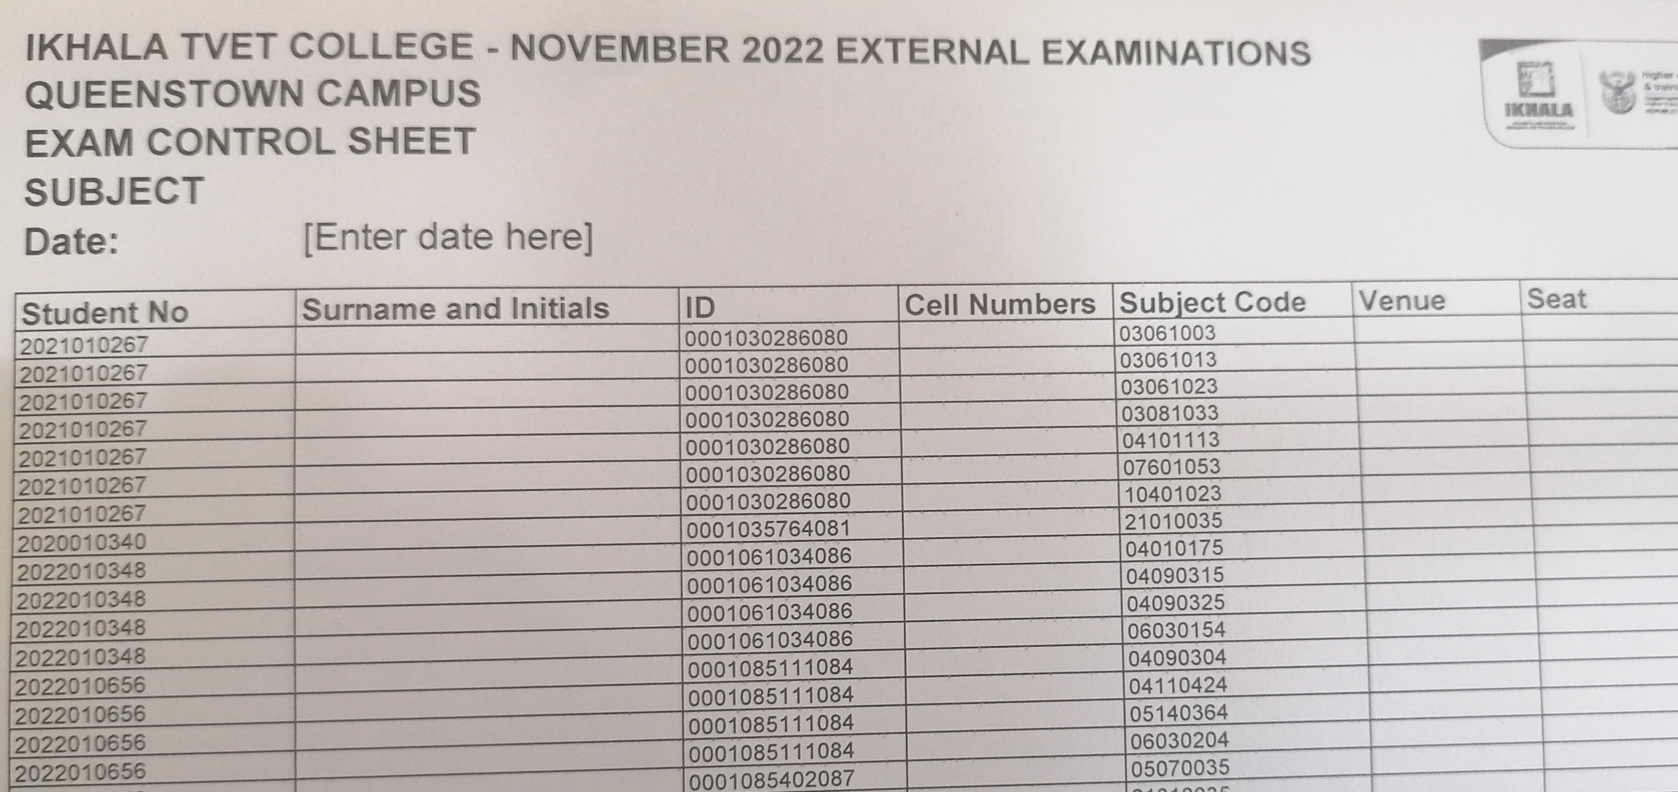
SEATING PLAN
Check your VENUE & SEAT
Check your subject

Slide 12
Items allowed in exam venue
Valid RSA ID (Compulsory to enter venue)
Passport (for candidates who are not RSA citizens)
Examination Permit (Compulsory to enter venue)
Writing utensils (Blue or Black pen)
Non-programmable calculator without a cover

Slide 13

Items NOT ALLOWED IN EXAM VENUE
Cell phones: Under NO circumstances allowed in exam venue IRREGULARITY
(Do not bring Cell phones to college during exams, College accepts no liability for losses)
Pencil cases & Pencil bags
Programmable calculators
Calculator covers
Hats/caps
No bags
No crib/sheet notes in any form – not on body, stationery, hair, exam permits, ID books
No books, notes, previous question papers or memos

Slide 14
BAGS
THE LECTURER MAY NOT KEEP YOUR CELLPHONE OR BAG FOR YOU, THEY ARE ON EXAM DUTY!
YOU MAY LEAVE YOUR BAGS IN THE DESIGNATED BAG – AT YOUR OWN RISK!

Slide 15
** As soon as you enter you are under the instruction of the Chief Invigilator
**Find correct seat according to seating plan
**Place Exam permit & ID on top left side of desk for duration of exam
**Complete cover of answer book correctly – see example below
**Follow instructions given by Invigilator
**Candidates whose exam numbers do not appear on the seating plan, are not allowed in the examination venue.
When you enter the exam venue

Slide 16

MAINTAIN ABSOLUTE SILENCE IN THE EXAMINATION VENUE!
When you enter the exam venue

Slide 17
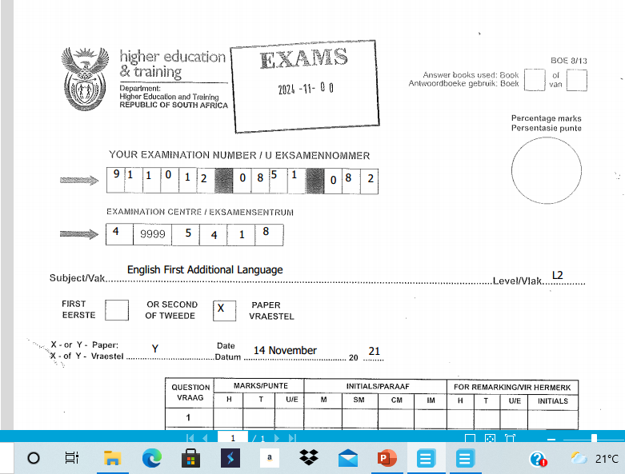
NOTE:
Unique code for the day
NC(V)
ANSWERBOOK

Slide 18
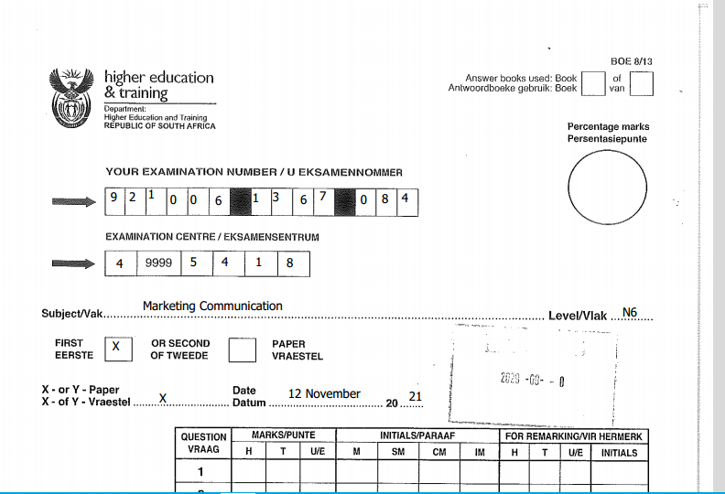

REPORT 191 ANSWER BOOK

Slide 19
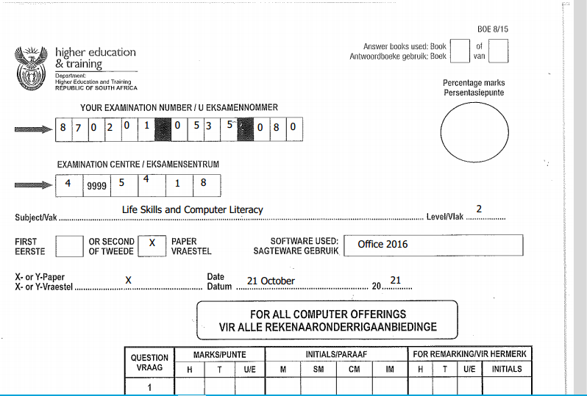
COMPUTER ANSWERBOOK

Slide 20
OPEN & CLOSED BOOK EXAMINATIONS
(REPORT 191 ONLY)
SUBJECT | OPEN BOOK | CLOSED BOOK | REFERENCE MATERIAL ALLOWED IN EXAM VENUE
Man. Comm N4 P1 | yes |  | TWO dictionaries and two additional reference works
Man. Comm N4 P2 |  | yes | TWO dictionaries (NO additional reference works)
Communication N4 – N6 P1 | Yes |  | TWO dictionaries AND two additional reference works
Communication N4 – N6 P2 |  | Yes | TWO dictionaries (no additional reference works)
Entrep. & Bus. Man N4 – N6 P1 |  | yes | NONE
Entrep. & Bus. Man N4 – N6 P2 | Yes |  | FIVE reference works: dictionaries, pocket calculator, textbook, student files containing lesson notes
PAST PAPERS AND MARKING GUIDELINES ARE NOT PERMITTED IN THE EXAM VENUE

Slide 21
COMPUTER – RELATED EXAMINATIONS
Make sure you are seated 40 minutes before the start of the Computer examination time
This time is for reading and implementing instructions.
All computer printouts must have the student’s examination number and watermark.
Printouts without identification or with handwritten identity number will NOT be considered for marking.
Candidates print during the examination. The invigilator will bring printouts to work station.
Save regularly. No extra time will be allocated for loss of work.
Save your work correctly.
TYPE SAVE PRINT !!

Slide 22
SPEED AND ACCURACY TEST: (Office Admin Students)
1. In the last 5 minutes BEFORE THE START of the examination, the candidates’ focus will be on the Speed & Accuracy test and they will be given 3 minutes to read through the Speed & Accuracy test
2. Candidates must wait until the invigilator gives the instruction to begin and stop.
3. The speed & accuracy test will be conducted ONCE ONLY
4. All uncontrolled speed & accuracy tests will NOT be marked.
COMPUTER – RELATED EXAMINATIONS

Slide 23
ABSENTEEISM FROM EXTERNAL EXAMINATIONS
IF you miss the exam because of a valid reason you may apply for exemption and a Supplementary Examination during the following examination cycle .
All medical notes / certificates must be submitted within 48 hours!
If the reason is NOT VALID / or the medical note was not received; you will have to repeat the subject full time.

Slide 24
Failure to produce valid ID or passport or exam permit
Report to reception for identification or reprint of your permit
Report to venue with document issued to you
Submit your valid ID within 24 hours to the Examinations Officer.
Failure to do so will result in your script being handled as an IRREGULARITY

Slide 25
Do not tear out ANY pages from the answer book
Ensure addenda are completed & inserted in your answer book
Only use exam numbers, NO NAMES
During the first hour, no candidate is allowed to leave the venue
Candidates to sign Attendance Register next to ID number
Candidates have to be escorted to the toilet and back (not during 1st hour)
DURING THE EXAMINATION SESSION

Slide 26
On completion of the exam candidates must remain seated and raise his/her hand to indicate to the invigilator to collect the answer script & question paper
A Candidate must sign for submission of answer book next to his/her ID number. During the last 15 minutes of the exam session, candidates must remain seated until all scripts, question papers and signatures are collected – no candidates allowed to leave the venue during last 15 minutes.
Candidates will sign the register indicating the time they left.
DURING THE EXAMINATION SESSION

Slide 27
Leaked question papers/marking guidelines. It is a criminal offence to make use of leaked information, Report leakages to Campus Management
Candidates found writing of behalf of other candidates
Failure to produce a valid ID
Late arrival at exam centre
IRREGULARITIES

Slide 28
IRREGULARITIES
Exam number not on mark sheet
Answer script damaged
Creating a disturbance or behave in an improper manner
Disorderly conduct
Disregard of instructions from Chief Invigilator/Invigilator
Disregard of Examination regulations

Slide 29
IRREGULARITIES
When found in possession of crib (cheat) notes or on cell phone, evidence will be confiscated.
New exam book issued to continue with exam.
An irregularity will be declared.
This is a serious offence!
A student may be barred from ANY institution for THREE years!

Slide 30

QUESTIONS?

Slide 31


Slide 32


